Slide 1

Orientation Programme on (OOP– CS/IT215)(R20)

Slide 2

Course Details
Course Code : CS/IT215
Title of The Corse : Object Oriented Programming
Year and Semester : B.Tech. Semester III [Second Year] (R20)
Periods / Week : Theory-3
Nature of The Course : Professional Core
PRE-REQUISITES : Programming for Problem
Solving(CS/IT114)
Name of The Instructor(s): Mr N.Hanumantha Rao,
Mr K.Siva Kumar,
Dr.A.Sri Nagesh.

Slide 3
Course Objectives:
To understand Java fundamental concepts.
To learn the fundamentals of object-oriented programming in Java.
To implement exception handling and multithreading.
To understand the concepts of Event Handling, Generics and Collections.

Slide 4
Course Outcomes:
Write programs using various Java Programming Constructs.
Develop reusable and efficient programs applying various OOP concepts.
Apply the concepts of Exception handling and Multithreading.
Design event driven programs and generic programs.

Slide 5
Syllabus UNIT-I
Introduction: The history and evolution of Java, Java Buzz words, object-oriented programming, Data Types, Variables and Arrays, Operators, Control Statements.
Classes and Objects: Concepts, methods, constructors, types of constructors, constructor overloading, usage of static, access control, this keyword, garbage collection, finalize () method, overloading, parameter passing mechanisms, final keyword, nested classes and inner classes.
Utility Classes: Date, Calendar, Scanner, Random

Slide 6
UNIT-II
Inheritance: Basic concepts, access specifiers, usage of super key word, method overriding, using final with Inheritance, abstract classes, dynamic method dispatch, Object class.
Interfaces: Differences between classes and interfaces, defining an interface, implementing interface, variables in interface and extending interfaces.
Packages: Creating a Package, setting CLASSPATH, Access control protection, importing packages.
Strings: Exploring the String class, String buffer class, Command-line arguments.

Slide 7
UNIT-III
Exception Handling: Concepts of Exception handling, types of exceptions, usage of try, catch, throw, throws and finally keywords, multiple catch clauses, nested try, Built-in exceptions, creating own exception sub classes.
Multithreading: The Java Thread model, thread life cycle, Thread class, Runnable interface, creating multiple threads, Synchronization, Inter Thread Communication, Deadlock.
Applets: Concepts of Applets, life cycle of an applet, creating applets Event Handling: Events, Event sources, Event classes, Event Listeners, Delegation event model, handling events.

Slide 8
UNIT- IV
AWT: AWT Components, File Dialog boxes, Layout Managers, Event handling model of AWT, Adapter classes, Menu, Menu bar.
GUI with Swing– Swings introduction, JApplet, JFrame and JComponent, Icons and Labels, text fields, buttons – The JButton class, Check boxes, Radio buttons. Combo boxes, TabbedPanes, Scroll Panes, Trees, and Tables
Generics: Basics of Generic Methods, Generic Classes
Collections: Collection Interfaces, Collection Classes, Accessing a Collection via an Iterator

Slide 9
Learning Resources:
TEXT BOOK:
Java The Complete Reference - Herbert Schildt11th Edition, Mc Graw Hill
Education.
REFERENCE BOOKS:
Introduction to java programming, 7th edition by Y Daniel Liang, Pearson.
JAVA one step ahead, Anitha Seth, B.L. Juneja, Oxford.
Cay.S. Horstmann and Gary Cornell, Core Java 2, Vol 1, Fundamentals 7th Edition, Pearson Education.
H.M. Dietel and P.J. Dietel, Java How to Program, Sixth Edition, Pearson Education/PHI.
Barbara Liskov, Program Development in Java, Addison-Wesley, 2001.
Cay Horstmann, John Wiley and Sons, Big Java 2nd Edition, Pearson Education.

Slide 10
Overview of Object Oriented Programming

Slide 11
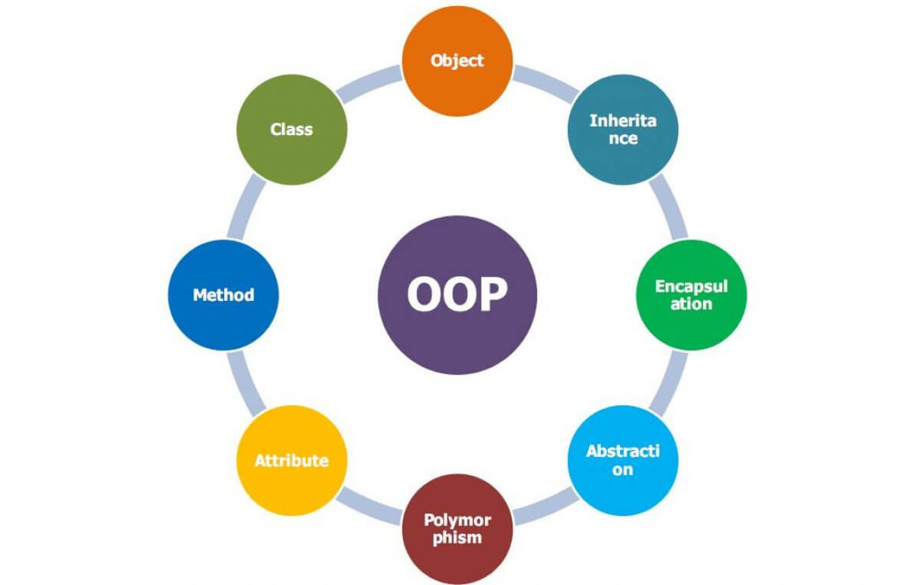
OOPS Principles:

Slide 12
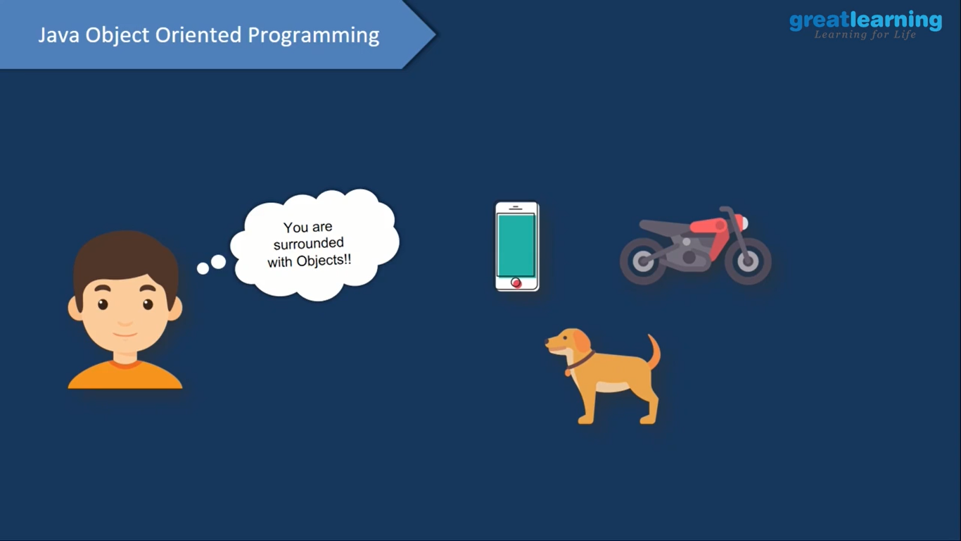
Object

Slide 13
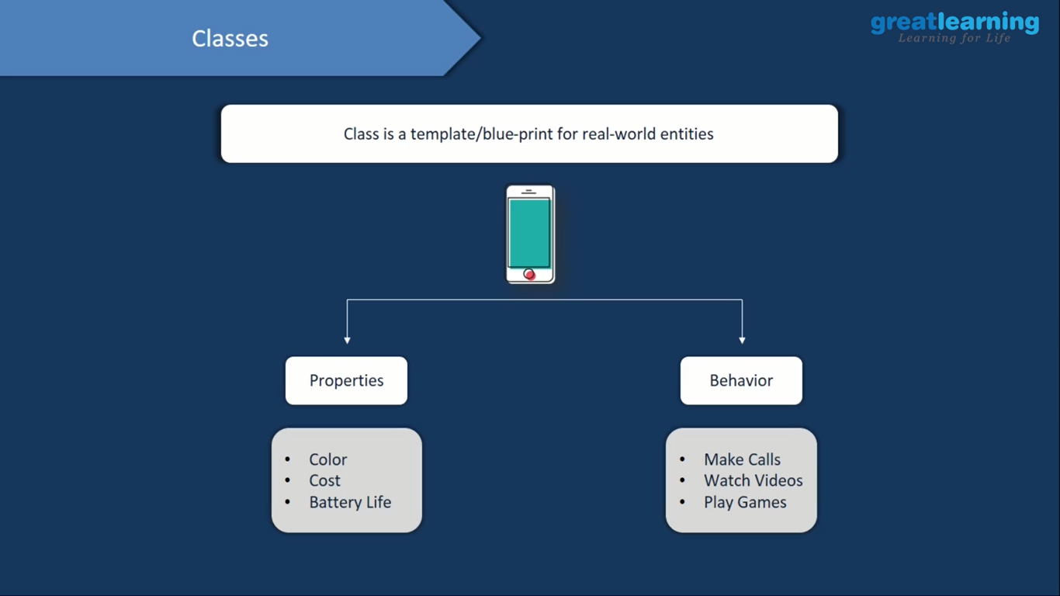
Class

Slide 14
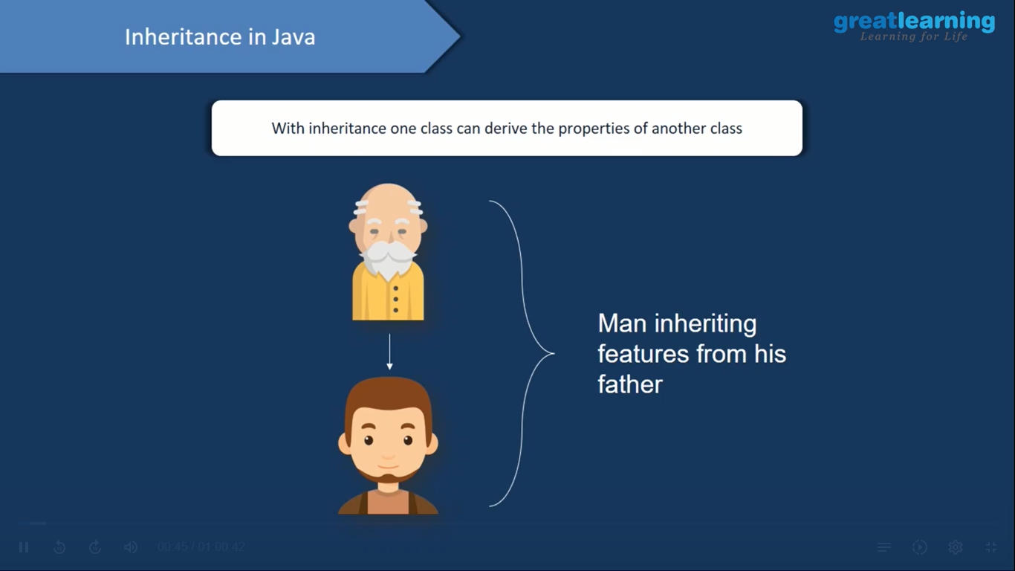
Inheritance

Slide 15
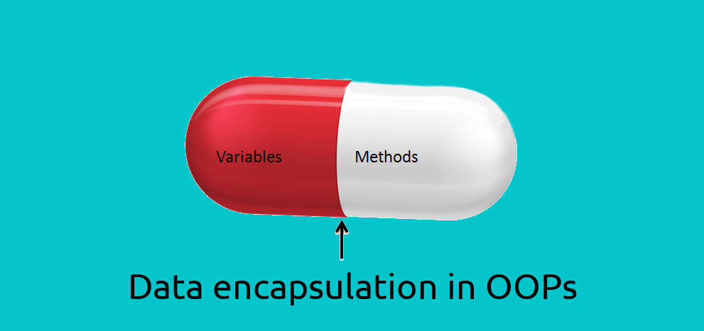
Encapsulation

Slide 16
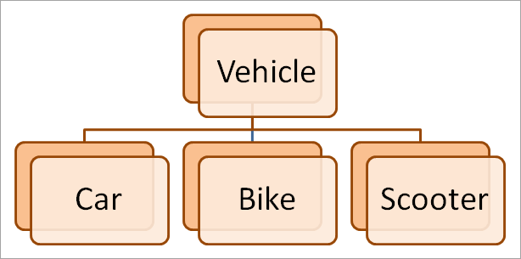
Abstraction

Slide 17
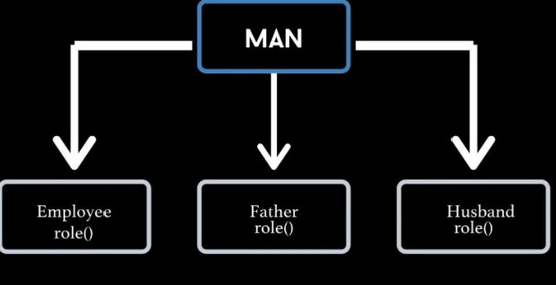
Polymorphism

Slide 18
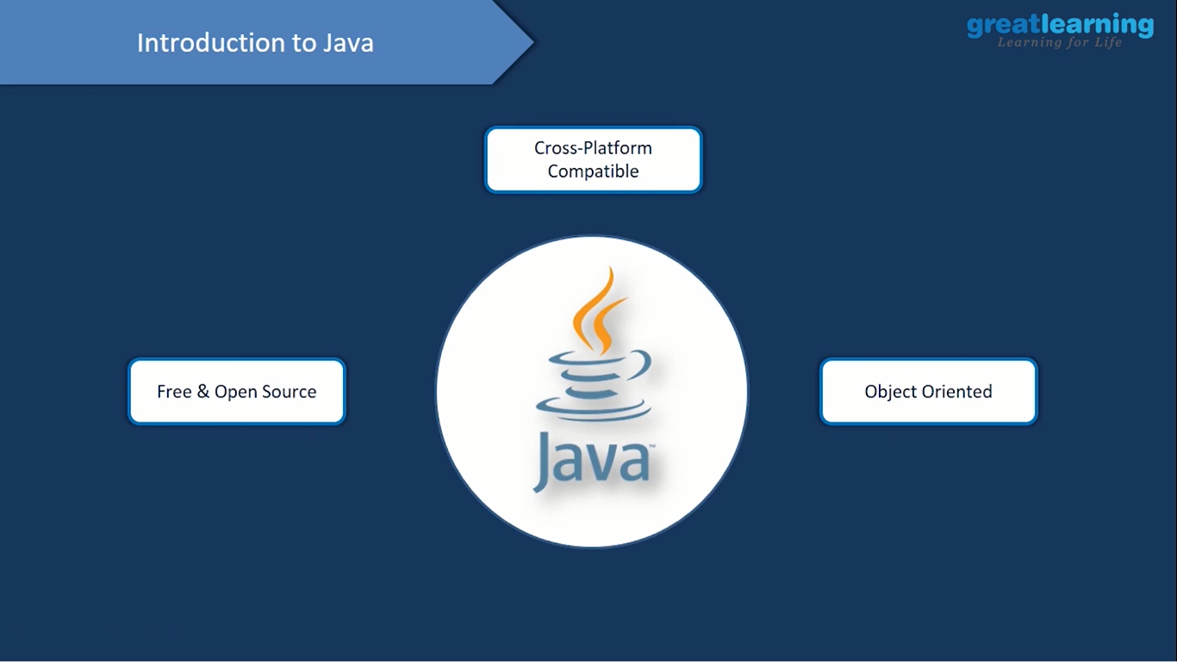
What is Java?
Notes:
Real world is continuous – an image is simply a digital approximation of this.

Slide 19
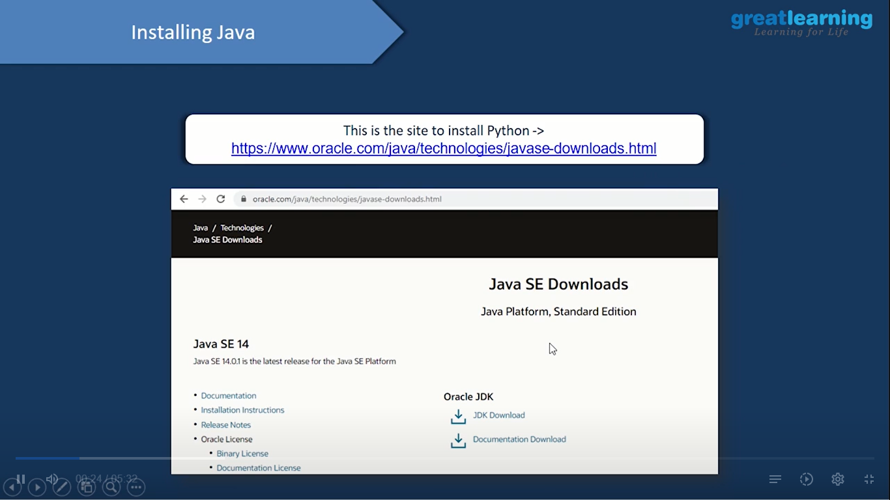
How to Download Java?

Slide 20
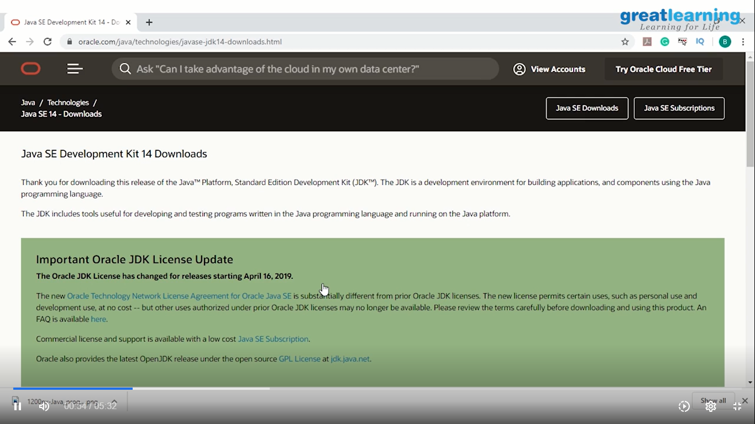

Slide 21
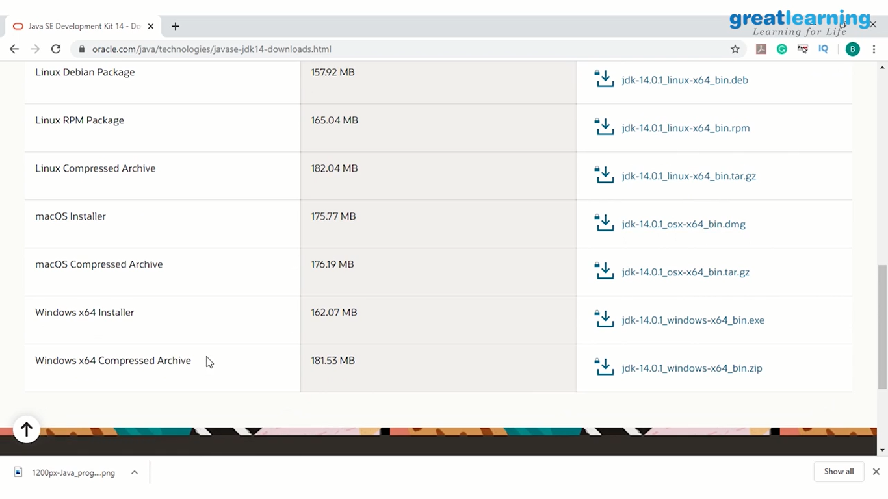
Select Platform

Slide 22


Java IDEs
NetBeans IDE
Eclipse IDE

Slide 23
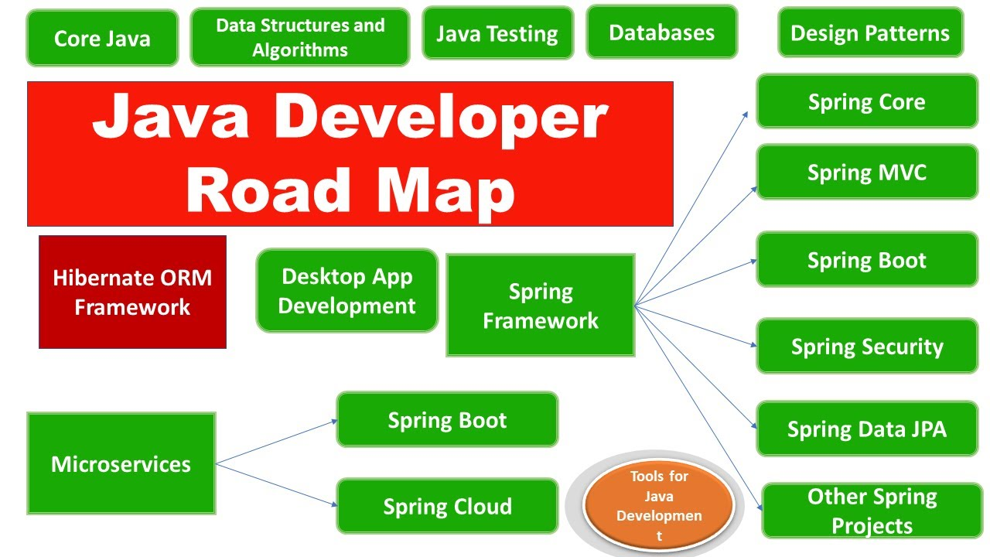
Job Opportunities:

Slide 24
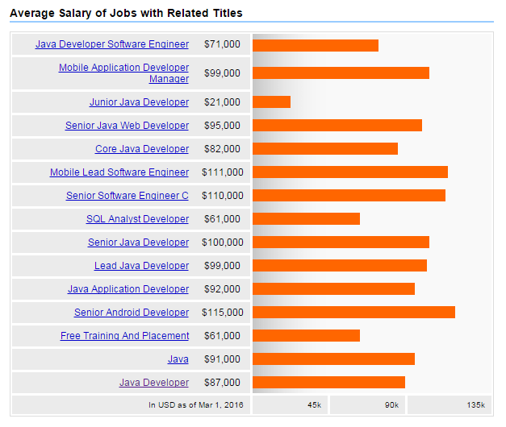
Package Details

Slide 25
Thank you!

